Slide 1
Implementation On SPI Protocol Using Verilog Code

Slide 2
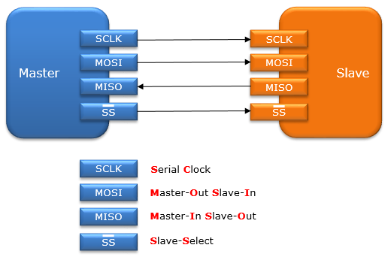
Introduction to SPI Protocol
SPI (Serial Peripheral Interface) is a synchronous serial communication protocol.
It allows full-duplex communication between a master and one or more slave devices.
Designed for high-speed data transfer, SPI operates using a clock signal to synchronize data transmission.
1
Notes:
Image source: https://piembsystech.com

Slide 3
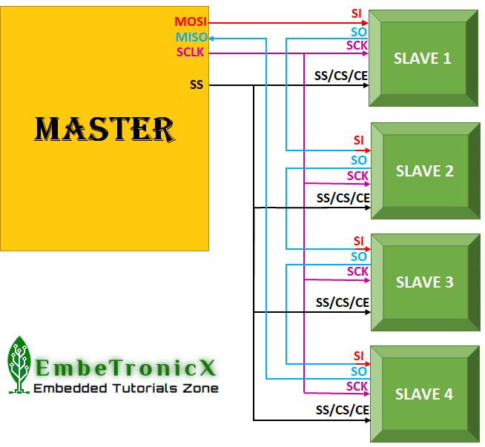
Key Features of SPI
SPI supports multiple devices on the same bus through chip select lines.
It provides configurable clock polarity and phase for compatibility with various devices.
The protocol is characterized by its simplicity and high-speed capabilities compared to other serial protocols.
2
Notes:
Image source: https://embetronicx.com

Slide 4
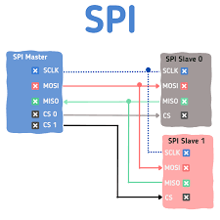
Basic SPI Architecture
The SPI architecture consists of a master device and one or more slave devices.
Each slave device is activated through a unique chip select (CS) line from the master.
Data is transmitted in a serial manner, using a clock signal generated by the master.
3
Notes:
Image source: https://www.makerguides.com

Slide 5
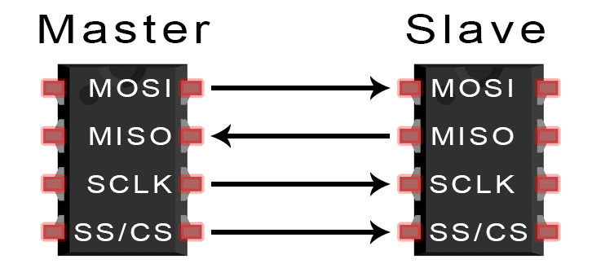
SPI Signal Lines
The four primary signal lines in SPI are MOSI, MISO, SCK, and CS.
MOSI (Master Out Slave In) carries data from the master to the slave.
MISO (Master In Slave Out) carries data from the slave back to the master.
4
Notes:
Image source: https://www.researchgate.net

Slide 6

Verilog Basics
Verilog is a hardware description language (HDL) used for modeling electronic systems.
It allows designers to describe the structure and behavior of digital circuits.
Verilog supports both behavioral and structural modeling, making it versatile for SPI implementation.
5
Notes:
Image source: https://www.slidemake.com

Slide 7
Verilog Modules for SPI
An SPI implementation consists of several Verilog modules, such as the master and slave.
Each module encapsulates its functionality, making the design modular and reusable.
Communication between modules is achieved through well-defined input and output ports.
6
Notes:
Image source: https://www.slidemake.com

Slide 8
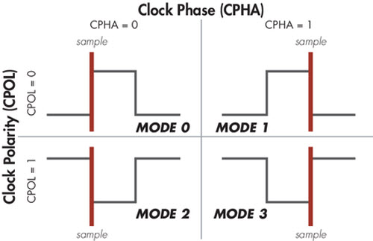
SPI Master Module
The SPI master module generates the clock signal for data transmission.
It manages the chip select signals to activate the appropriate slave device.
The master also handles data transmission and reception through MOSI and MISO lines.
7
Notes:
Image source: https://www.totalphase.com

Slide 9
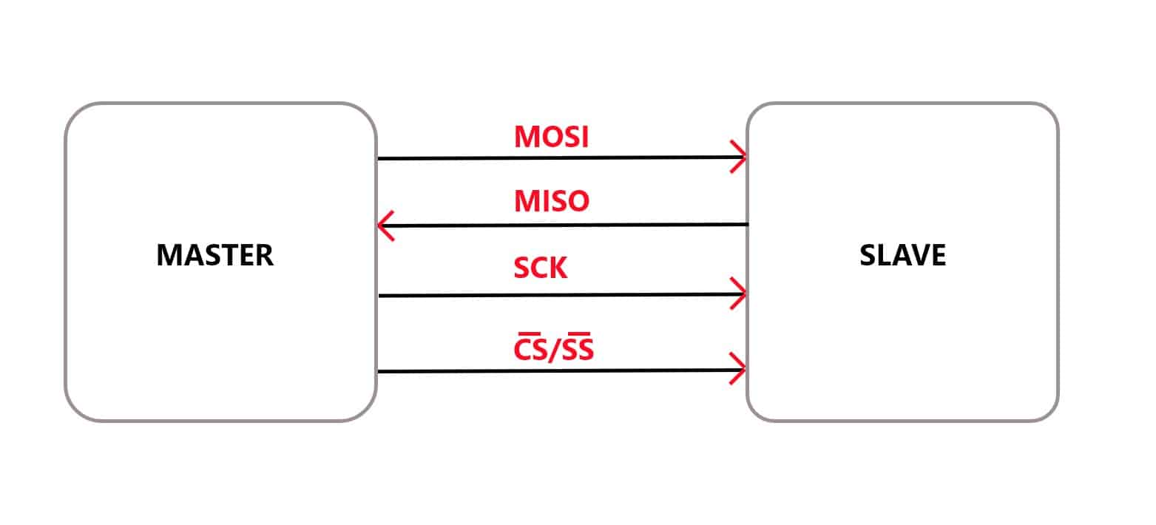
SPI Slave Module
The SPI slave module responds to the clock and chip select signals from the master.
It receives data on the MOSI line and sends data back on the MISO line.
The slave's functionality is often dependent on the specific application or device it serves.
8
Notes:
Image source: https://www.makerguides.com

Slide 10
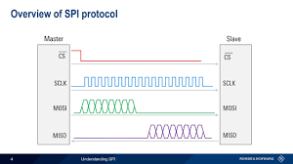
Clock Generation in SPI
The clock generation is crucial for synchronizing data transfer in SPI.
The SPI master produces a clock signal that dictates the timing of data transmission.
The clock frequency can be adjusted to meet the requirements of different slave devices.
9
Notes:
Image source: https://dlnware.com

Slide 11
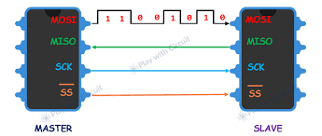
Data Transmission Process
Data transmission begins when the master asserts the chip select line for the desired slave.
The master sends data bits on the MOSI line while the slave receives them.
Simultaneously, the slave sends its data on the MISO line back to the master.
10
Notes:
Image source: https://www.slidemake.com

Slide 12
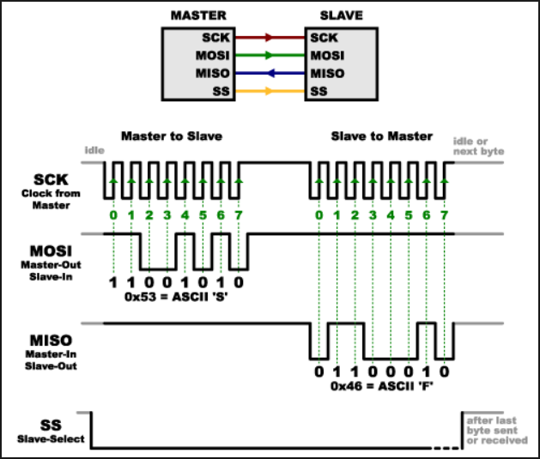
Verilog Code Structure
Verilog code for SPI typically includes definitions for registers and wires.
The state machine logic is used to control the flow of data and state transitions.
Behavioral constructs like always blocks help implement the timing and control logic.
11
Notes:
Image source: https://user-images.githubusercontent.com

Slide 13
Simulation and Testing
Simulation is a critical step in verifying the SPI implementation in Verilog.
Testbenches are created to simulate various scenarios and validate functionality.
Waveform analysis helps in understanding signal timing and data integrity.
12
Notes:
Image source: https://www.researchgate.net

Slide 14
Common Challenges
Timing issues can arise due to clock domain crossings or propagation delays.
Ensuring data integrity is vital, especially at high clock speeds.
Handling multiple slaves requires careful management of chip select signals.
13
Notes:
Image source: https://bltinc.com

Slide 15
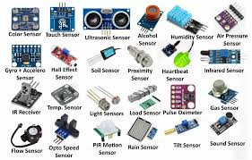
Applications of SPI
SPI is widely used in microcontrollers and digital signal processors.
It is commonly found in applications like sensors(temp, pressure), memory devices, displays and also in DAC ,ADC,EEPROM .
The protocol's versatility makes it suitable for a range of embedded systems.
14
Notes:
Image source: https://partimages.globalspec.com

Slide 16
Conclusion and Future Work
Implementing SPI in Verilog is an effective way to create high-speed communication interfaces.
Future work may include optimizing for low power consumption and higher data rates.
Exploring advanced features like multi-master configurations can further enhance SPI applications.
15
Notes:
Image source: https://www.slidemake.com

